Slide 1
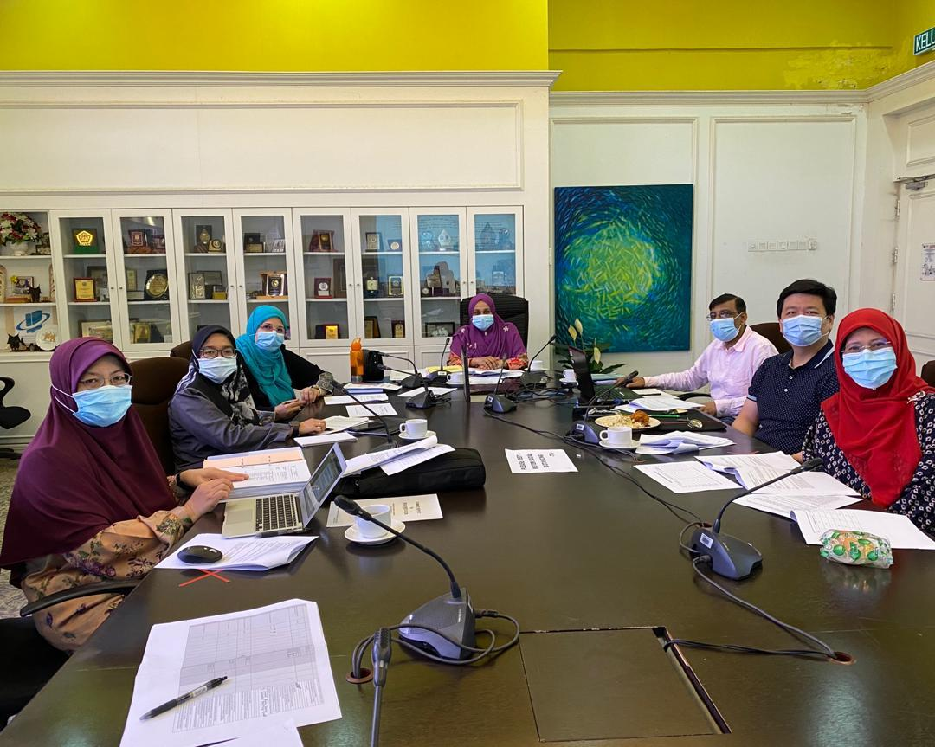
Leading Change in Higher Education Management in the Post - Covid-19 Era
Assoc. Prof. Dr. Husaina Kenayathulla
Head
Department of Educational Management , Planning and Policy
Faculty of Education
University Malaya
husaina@um.edu.my

Slide 2
Introduction
The covid-19 pandemic has disrupted many aspects of our lives.
The global lockdown of educational institutions has led to major interruptions in students’ learning; disruptions in internal assessments; and the cancellation of public examinations or replacement by alternative assessments.

Slide 3
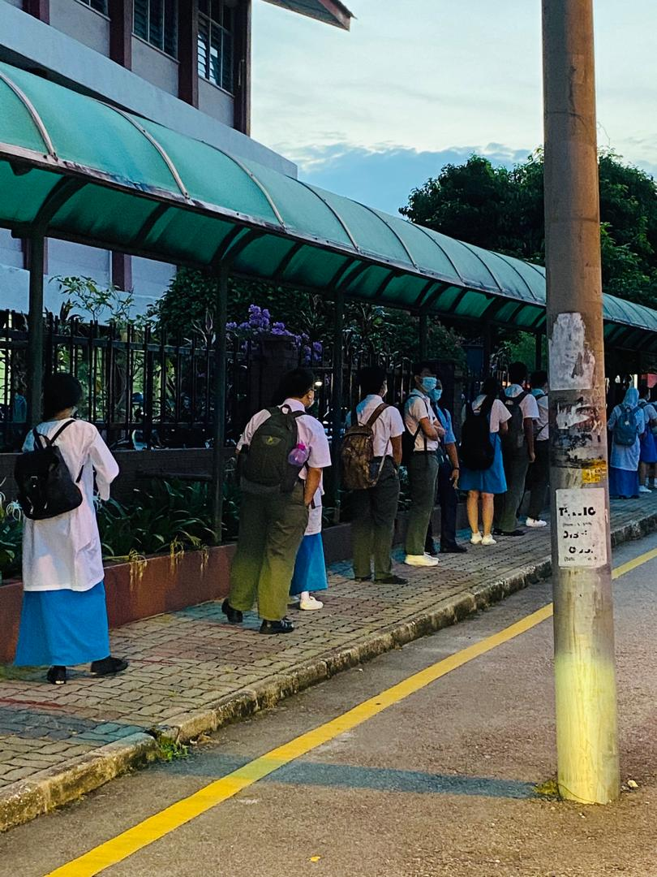
Introduction
However, Covid-19 has become the catalyst for educational change.
Many governments in the world have implemented various strategies to ensure that teaching and learning continues regardless of this pandemic.

Slide 4
The New Norms
Covid-19 has provided the opportunity for innovative ways of teaching and learning both at the school level and higher institution level.
Educators around the globe are being compelled to suddenly harness and utilize the available and appropriate technological tools to create content for remote learning.

Slide 5
Leading Transformational Change
Educators are leading transformational change by attempting things differently and employing greater flexibility resulting in potential benefits in accessibility to education.
Malaysia provides an interesting example of how educational leaders address this transformational change through strategic planning and implementation measures.

Slide 6
Leading Change
Leading change sees change as an opportunity, not a problem, challenges the system when change is needed, thrives in ambiguous situations, encourages creativity and innovation in others, effectively translates creative ideas into business results.

Slide 7
Strategies for Leading Change
1. Urgency is essential. Why does this change matter, why now?
What needs to change and what does the future look like? Reassure people that it’s not going to be easy but that change is possible.

Slide 8
Strategies for Leading Change
2. Resistance is common, anticipate it.
Determine who supports (or against) the change and why?
Sometimes people need more information, sometimes people need a chance to internalize the change.

Slide 9
Strategies For Leading Change
3. It takes time. Change can happen quickly, transition varies from one person to the next.
As William Bridges explains,
“Change is situational…. Transition is the psychological process people go through to come to terms with the new situation. Change is external, transition is internal.

Slide 10
Strategies For Leading Change
4. Do NOT exceed the capacity for change
When you put more change into the system than your people have capacity, you cannot successfully complete all the changes or achieve the intended benefits.

Slide 11
Strategies For Leading Change
5. Create certainty during uncertainty
Leading change well means providing milestones along the change journey. You don’t need to know all the answers but you do need create as much certainty as possible for your people regarding what’s next.

Slide 12
Strategies For Leading Change
6. Connect the dots.
Start with the who. Who are you speaking with? What matters most to them?
Meet them where they are and then follow that with the why.
Why is the change important? Why this? Why now? Then explain how all the pieces fit together.

Slide 13
Strategies For Leading Change
7. Focus on building trust
When you are leading change, focus on building trust since it’s the most essential element of leading successful change.

Slide 14
Creating a More Inclusive and Engaged Approach to Change
There are benefits of ongoing engagement in change process by as many and as diverse stakeholders, as practicable
(Devecchi et al. 2018)
Exploring the external context through collaborative dialogue is a very strong approach of involving people at the early stage of change.

Slide 15
Leading Transformation in Teaching and Learning
Need to be deeply based, linked to values, student-centered and sustainable.
Learning together, challenging assumptions, being curious and creative, and going beyond self interest.
Leaders will move followers to go beyond their own self-interest for the good of their organization or society.

Slide 16
Teach Online

Slide 17
Higher Institutions Teaching & Learning

Slide 18
The Post Covid-19 Social Distancing Pedagogical Elements
The Post Covid-19 Social Distancing pedagogical elements comprise of synchronous and asynchronous learning strategies, teaching and learning activities and assessments.

Slide 19
Synchronous Learning
Synchronous learning is the kind of learning that happens in real time. This means the interaction with students and instructor occurs in a specific virtual place, through a specific online medium, at a specific time.
Video call (zoom, google meet, whatsapp video call, etc)

Slide 20
Strategies
May include:
Conduct live online lectures;
Invite guest speaker(s) to the online session; and
Conduct live teaching sessions using other communication channels including WhatsApp and Telegram.

Slide 21
Synchronous sessions
Teaching & Learning may be flexible and can be divided into several sections.
For instance, in a 3-hour class session:
1st hour is allocated for online lecture;
2nd hour is dedicated for online group discussions; and
3rd hour is for online group presentations.

Slide 22
Asynchronous Learning
Asynchronous learning happens on your schedule. While your instructor provides materials for reading, lectures for viewing, assignments for completing, and exams for evaluation, you have the ability to access and satisfy these requirements within a flexible time frame.
Recorded lecturers can be uploaded so that students can view at their own time

Slide 23
Alternative Assessment
Online Quiz.
Online forums.
Take home exams
Recorded video presentations posted in youtube

Slide 24
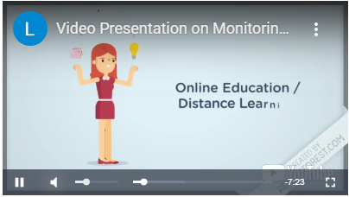
Students Assessments
https://www.youtube.com/watch?v=8epjYmIHAdo&feature=youtu.be

Slide 25
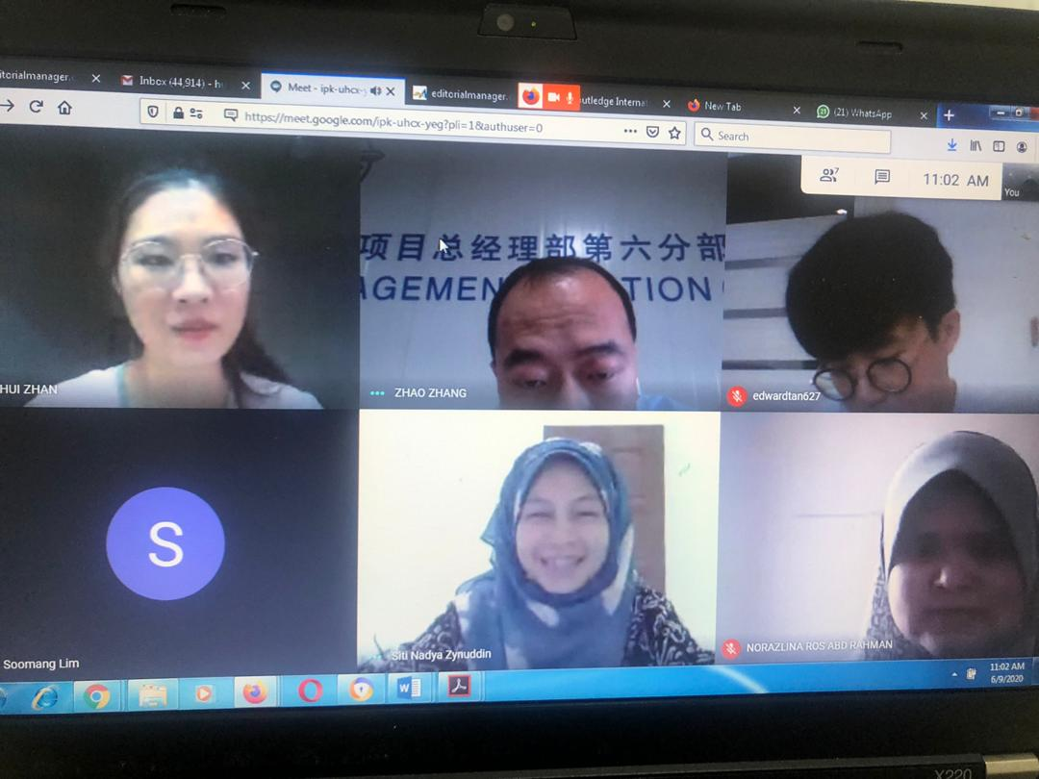
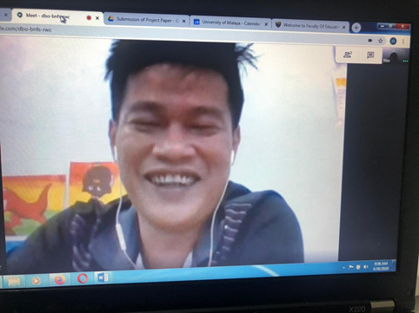
PhD Students’ Supervision During Movement Control Order (MCO) and Post Covid-19 Period

Slide 26
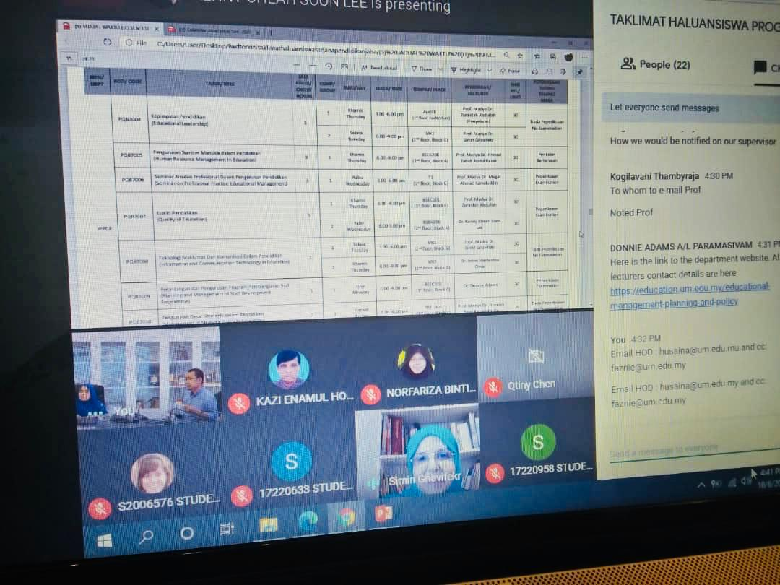
Online Students’ Orientation

Slide 27
Research on Social Distancing Pedagogy for Post Covid-19 Pandemic Teaching and Learning

Slide 28
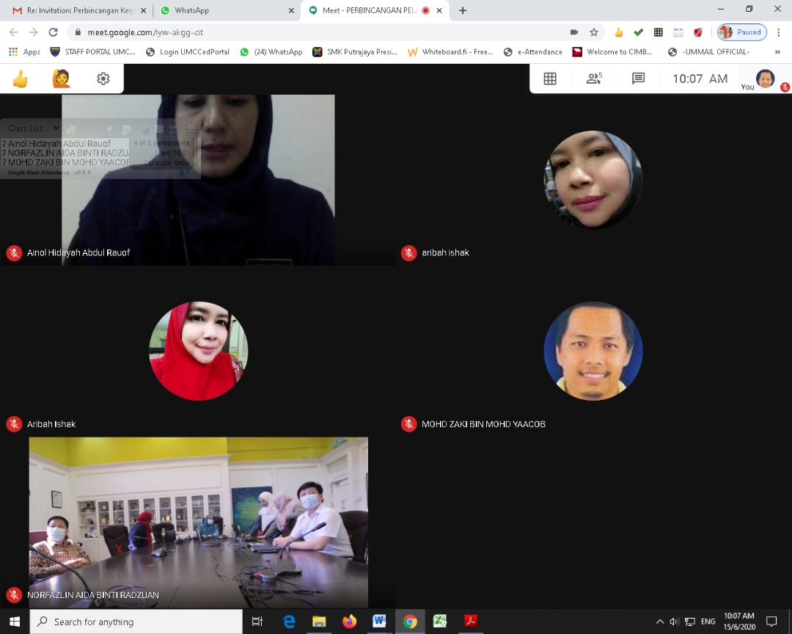
Faculty – Student Discussion

Slide 29
Guidelines for Research
No travelling is allowed to red zones
Online interview and forum are encouraged
Online questionnaires are encouraged
Research presentation through online platform
Ethical procedures need to be complied

Slide 30
Institutional Initiatives
Students from lower socio-economic background are provided internet and data plan so that they have access to internet.
Those without conducive learning environment are given priority to return to hostels and they are placed in the hostels following all the standard operating procedures.

Slide 31
Institutional Initiatives
It is important for management to realize not all staff have all the necessary devices and facilities to work from home
Each department was asked to identify staff who do not have internet facilities or laptop at home
They can borrow laptops from institutions when they work from home
Management allows only 30 percent of the staff to come if urgent necessity arise

Slide 32
Way Forward
Provide insights to policymakers on the readiness of our students, teachers and parents to change.
Our limited resources to enable teaching and learning.
Professional development for academicians is essential.
Innovative ways of teaching and learning.
Smart partnerships with diverse ststakeholders.

Slide 33
THANK YOU

